Slide 1
CS35L Software Construction Laboratory
Nandan Parikh
Week 1 : Lecture 1
WINTER 2019

Slide 2
About this course
Course Syllabus : https://web.cs.ucla.edu/classes/winter19/cs35L/syllabus.html
Why this course?
To get accustomed to the most commonly used software environments and tools to be used in upper division CS classes
Linux, scripting, VMs, version control management, systems programming, low-level construction, parallelism, etc.

Slide 3
Course Logistics
3 credit course
Structure: 9 assignments (Lab + HW), 1 report + Presentation
1 Final exam – 3 hour exam
PTEs
SEASnet account mandatory!
Use piazza for questions
Office Hours:
This week Friday 11 am – 1 pm Boelter 3256S

Slide 4
Course Logistics contd…
Grading : 50% HW and 50% Final exam
Lateness penalty: N days late -> 2^{N} % of assignment deducted
All assignments due by 23:55 of the specified date
Assignment 1 due on 12th Jan 23:55
Instructions for 3760 BH
Do not carry food or liquid inside.
Always logout if you use the computers in lab
My email id : nandanparikh@cs.ucla.edu

Slide 5
About SEAS account and its connection
Create account from https://www.seas.ucla.edu/acctapp/
Connect to lxnsrv server
Install PuTTY SSH client (highly recommended) : Follow instructions on http://www.seasnet.ucla.edu/lnxsrv/
Remember your SEAS username and password! (will mostly be different from your UCLA login and password)
Use host lnxsrv.seas.ucla.edu and port 22 in PuTTY

Slide 6
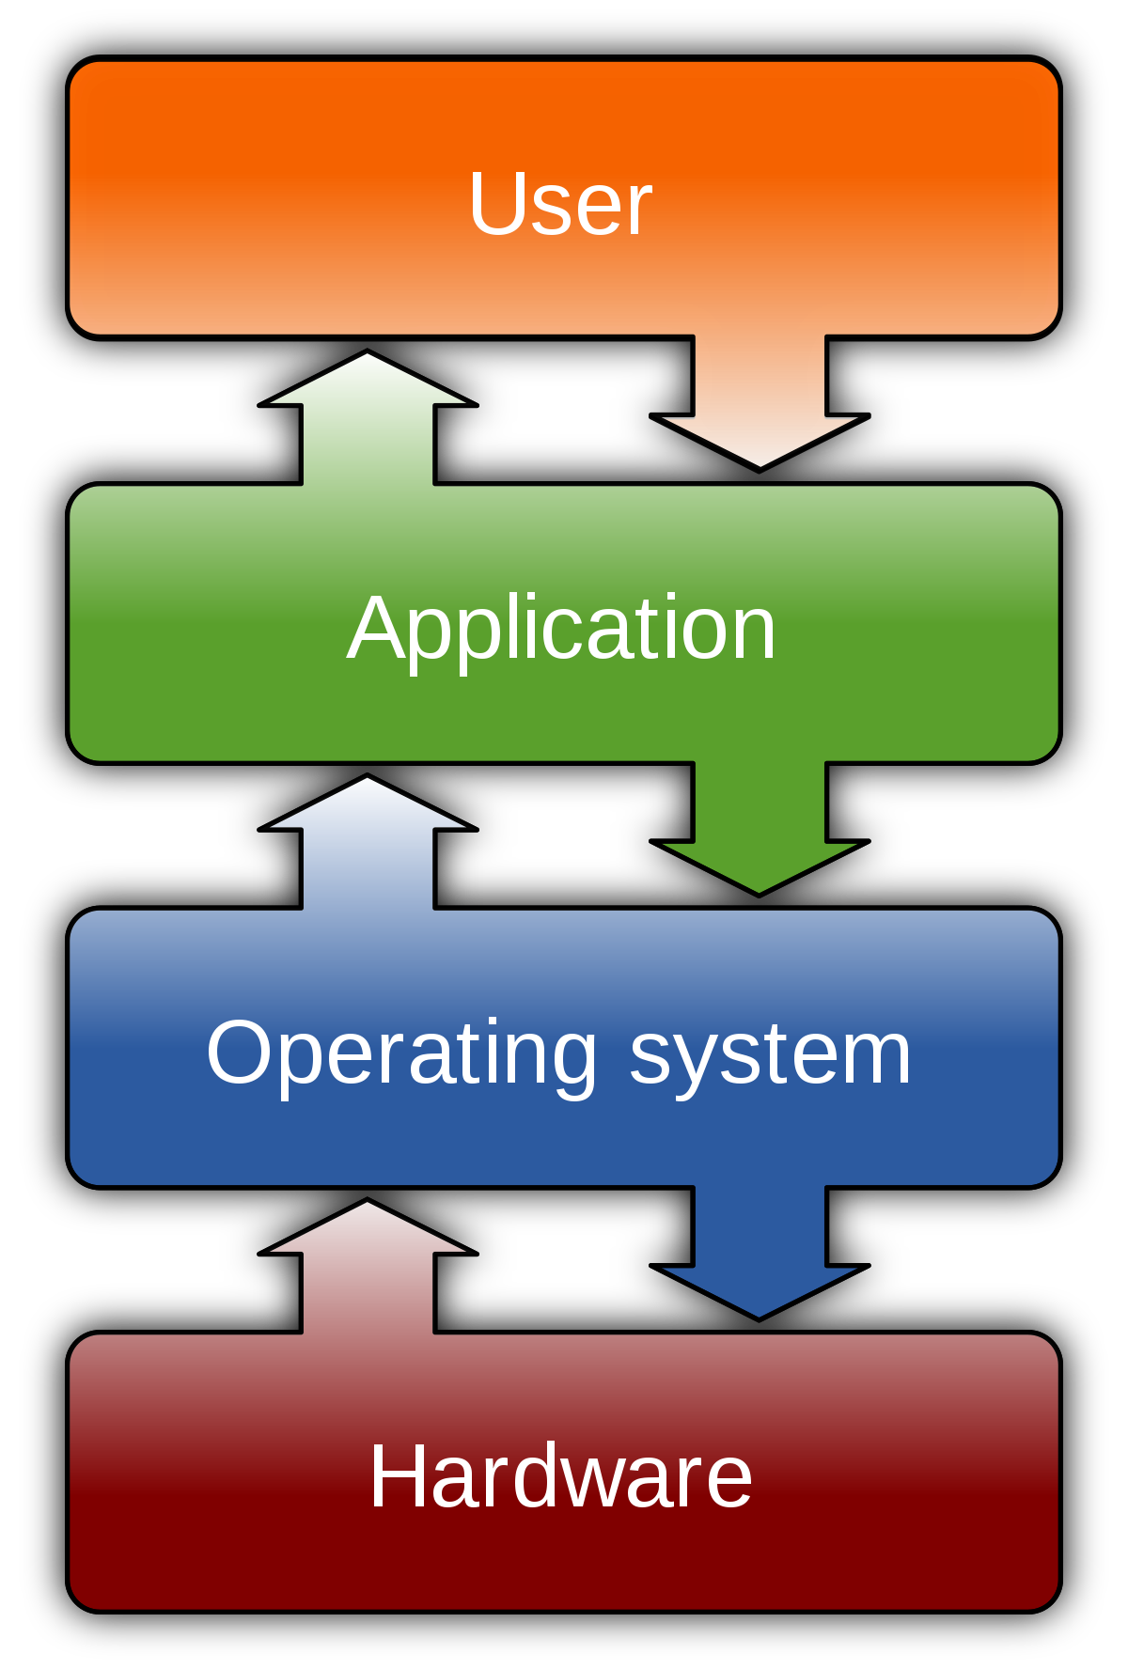
What is an Operating System?
Most important software that runs on a computer
Manages memory, processes, other softwares and hardwares
Makes human to computer communication easy
Computer is useless without an OS!
Brief history of Operating Systems: http://www.informit.com/articles/article.aspx?p=24972
OS Examples : Windows ( Windows 10, 8.. ), MacOS (OS X), UNIX
Source : https://en.wikipedia.org/wiki/Operating_system

Slide 7
Multiuser and Multi-process Operating System
Multi-User OS- Allow many users to access/work on a single system at the same time (as long as they have their own terminal)
Multi-Process OS- Allows many processes, programs and applications to run simultaneously.
Variants :
Single User Single Task
Single User Multi Task
Multi User OS

Slide 8
Open Source Software
What is an open source software?
Source code is publicly available
Modification by any individual allowed on a global scale
It is free for use
Examples: Firefox, Android, Linux

Slide 9
User Interfaces: CLI v/s GUI
Command Line Interface
Steep learning curve
Pure control (e.g., scripting)
Speed: Only keyboard, faster performance
Consumes less resources
No change; less diverse
Graphical User Interface
Intuitive
Limited Control
Mouse + keyboard; Slower
More resources; e.g. loading icons, fonts, etc.
Frequent changes; More diverse

Slide 10
Debian GNU/Linux
Clone of UNIX
Linux is just a kernel.
What is a kernel?
Core of any OS
Allocates time and memory to programs
Interfaces applications with the physical hardware
Allows communication between different processes: inter-process communication (IPC)
Linux distribution make the Linux kernel a completely usable OS by adding various applications
Linux distribution = GUI + GNU utilities (cp,mv,ls,etc) + installation and management tools + GNU compilers (c/c++) + Editors(vi/emacs) + ….
Shell : Interface between the user and kernel

Slide 11
Basics of Shell
Outermost layer around the kernel; hence called shell !
Can be used as CLI as well as GUI depending upon the task/operation
Examples:
CLI shell in Windows :
Command Prompt
CLI shell in UNIX :
Shell
CLI in Mac :
Terminal
Basic shell commands:
<up arrow>: previous command
<tab>: auto-complete
!!: replace with previous command
![str]: refer to previous command with str

Slide 12
Files and Processes
Everything is either a process or a file
Process: an executing program identified by PID
File: collection of data
A document
Text of program written in high-level language
Executable
Directory
Devices

Slide 13
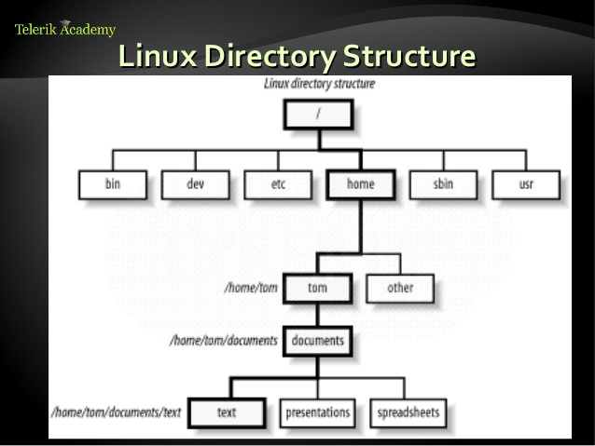
Linux File System Layout
Tree Structure Hierarchy
Only One Root- ‘/’
Directories are also files
E.g. home, tom
Regular files can only be leaves
E.g. text, spreadsheets, etc
Source: https://www.slideshare.net/azilian/4-linux-file-systems-18175783

Slide 14
The Basics: Moving Around
pwd: print working directory
cd: change directory
~ home directory
. current directory
/ root directory, or directory separator
.. parent directory

Slide 15
The Basics: Dealing with Files
mv: move/rename a file
cp: copy a file
rm: remove a file
r: remove directories and their contents recursively
mkdir: make a directory
rmdir: remove an empty directory
ls: list contents of a directory
d: list only directories
a: list all files including hidden ones
l: show long listing including permission info
s: show size of each file, in blocks

Slide 16
The Basics: Changing File Attributes
ln : creates a link
Hard links : Point to physical Data
Additional name for an existing file
ln file1 hlink1
Soft Links/ Symbolic Links (-s): Point to file
ln –s <source file> <my file>
touch: update access & modification time to current time
touch filename
touch -t 201101311759.30 filename
Change filename’s access & modification time to (year 2011 January day 31 time 17:59:30)

Slide 17
The Basics: File Permissions

Slide 18
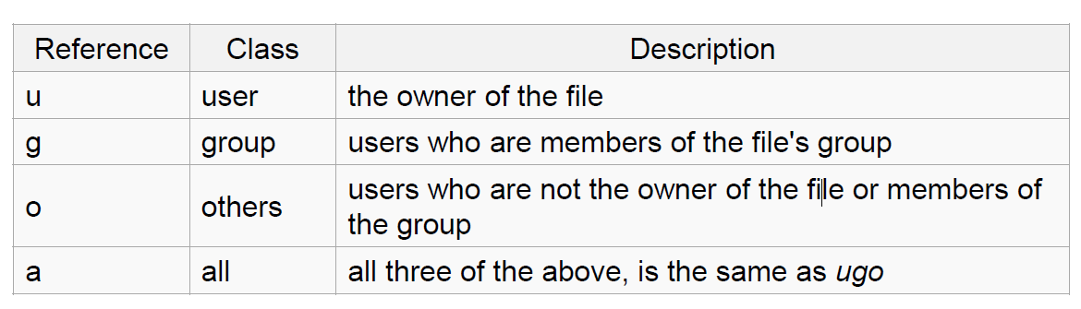
File Permissions
chmod
read (r), write (w), executable (x)
User, group, others

Slide 19
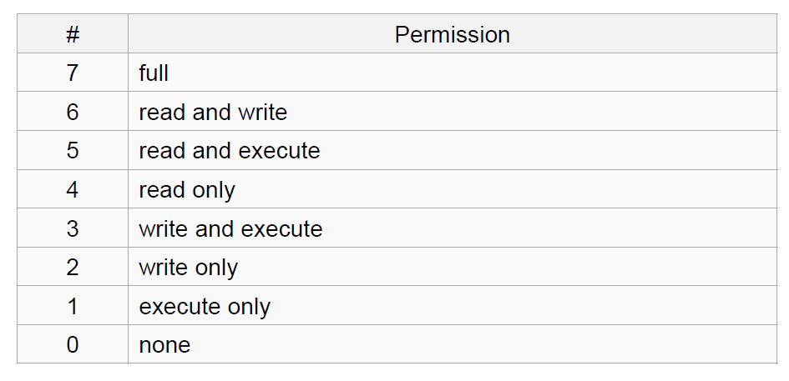
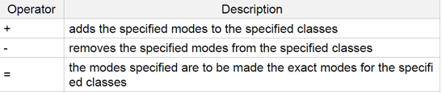
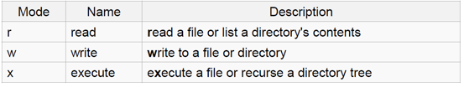
chmod contd…
Numeric
Symbolic

Slide 20
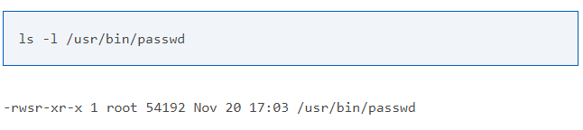
Special permissions
setuid : set user ID on execution
Permits users to run certain programs with escalated privileges
E.g. : chmod u+s file1
When an executable file’s setuid permission is set, users may access the program with a level of access that matches the owner
E.g. passwd command

Slide 21
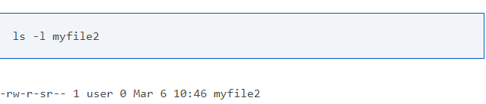
Special permissions contd…
setgid : Grants permission of the group which owns the file
E.g. : chmod g+s file2

Slide 22
Basic Shell Commands
man
cat
head
tail
du
ps
kill
diff
cmp
wc
sort
echo

Slide 23
The Basics: Redirection
> file: write stdout to a file
>> file: append stdout to a file
< file: use contents of a file as stdin

Slide 24
find command
-type: type of a file (e.g: directory, symbolic link)
-perm: permission of a file
-name: name of a file
-user: owner of a file
-maxdepth: how many levels to search

Slide 25
find contd…
?: matches any single character in a filename
*: matches one or more characters in a filename
[]: matches any one of the characters between the brackets. Use ‘-’ to separate a range of consecutive characters.
Examples:
find . -name my*
find . -name my* -type f
find / -type f -name myfile

Slide 26
man command
Extensive documentation that comes preinstalled with almost all substantial Unix and Unix-like operating systems
Usage
read a manual page for a Linux command
man <command_name>
Hit “q” to get out of man page

Slide 27
wh commands
whatis <command>: returns Name section of man page
whereis <command>: locates the binary, source, and manual page files for a command
which <command>: locates only the binary

Slide 28
diff command
A file comparison utility that outputs the differences between two files.
Usage:
diff file1 file2
diff –u file1 file2 (unified format)

Slide 29
wget command
A computer program that retrieves content from web servers
Usage
wget <URL>

Slide 30
vi editor
Open a file- vi <filename> or vim <filename>
Close a file- :q
Save a file- :w
Save and close a file- :wq
Modes:
Normal: Enter commands
Insert: Insert text
Visual: Like normal, but you can highlight
Replace: Like insert, but you replace characters as you type
Recording: Record a sequence of key sequences

Slide 31
Emacs editor
“The customizable, extensible, self documenting display editor”
Customizable (no programming)
Users can customize font, colors, etc
Extensible (programming required)
Run Lisp scripts to define new commands
Self-documenting
C-h r (manual) and C-h t (tutorial)
https://www.gnu.org/software/emacs/refcards/pdf/refcard.pdf
http://bit.ly/2CQy3H8 (some basic commands)
http://stanford.io/2CTWNyl

Slide 32
Getting started with emacs
emacs already installed in linux servers
Type emacs to enter into the editor
Emacs has both GUI and CLI
All emacs commands start with ‘C’ or ‘M’
‘C’ = ctrl; ‘M’ = alt (windows)/ option (Mac)
Start emacs
emacs <filename>
Exit emacs
C-x C-c

Slide 33
Basic emacs editing
Insert text by simply typing it
Undo by typing C-x u
Save changes by typing C-x C-s
Copy, cut, paste
C-space (starts selecting region)
M-w (copy a region)
C-w (cuts a region)
C-k (kill a line)
C-y (yank/paste)

Slide 34
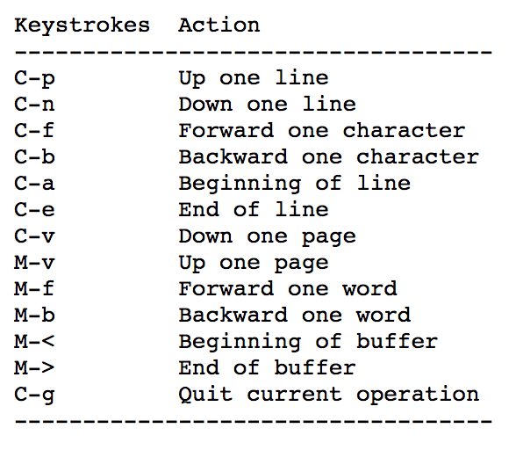
Moving around

Slide 35
More emacs commands
Search – C-s
Replace – M-%
Accessing menu – F10
Switch buffer – C-x b
Switch current window – C-x o
Kill the current window – C-x 0 (zero)
Help – C-h

Slide 36
Directory edit (dired) (C-x d)
Creates an Emacs buffer containing list of directory contents
Allows you to operate on files
Allows you to navigate filesystem
+ - new directory, C-x C-f new file in directory, g - refresh dired buffer
! - run shell command
https://www.gnu.org/software/emacs/refcards/pdf/dired-ref.pdf

Slide 37
Other features
Emacs as lisp interpreter
Use scratch buffer
type (random) or (+ 1 2) or (setq x 2) then C-j
M-: and an expression to evaluate, e.g. ( * 1 2 3)
Run shell command - M-!

Slide 38
Assignment 1: Example key1.txt
key1.txt is for both LABORATORY and HOMEWORK section
C-s H E L L O W O R L D
C-s H T M L
C-d
C-n
M-x goto-line Enter 1 2 3 Enter

Slide 39
Assignment 1: Example ans.txt
ans1.txt is specifically for LABORATORY section
1. Here is the answer to question 1
2. Here is the answer to question 2
3. Here is the answer to question 3
…..

